Slide 1
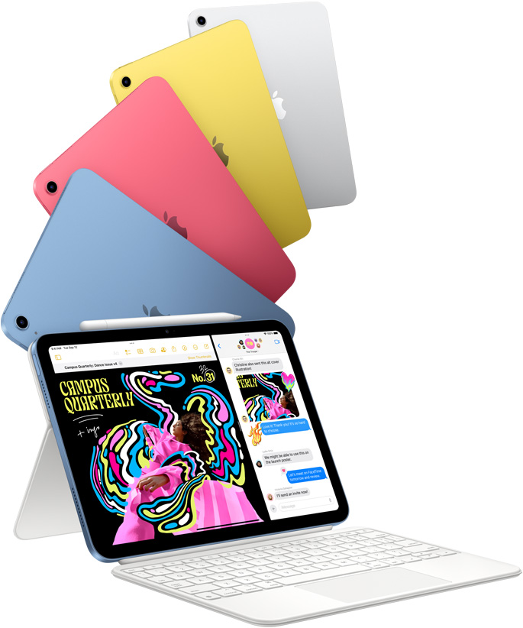
Live Auction – starting at 7:30 pm
Apple iPad10th generation
Lovable. Drawable. Magical.
Made possible by
12MP Wide back camera.
Trackpad for precision tasks, like editing a spreadsheet, with the Magic Keyboard Folio.
Download files, play games online, and stream movies with Wi-Fi 6.
superfast connections with 5G.
Connect to drives, docks, displays,
and more using USB‑C.
high-quality built-in mics and landscape stereo speakers.
A14 Bionic chip

Slide 2
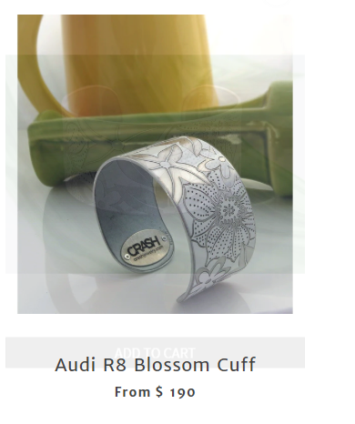
Live Auction - starting at 7:30 pm
Made possible by
https://www.crashjewelry.com/
Fashion jewelry, created from crashed cars. Built with car enthusiasts in mind, the jewelry pays homage to the car it came from.
A purchased piece of CRASH Jewelry comes with an official registration card with all of the vehicle information and even a CRASH Jewelry VIN.

Slide 3
Live Auction – starting at 7:30 pm

Slide 4
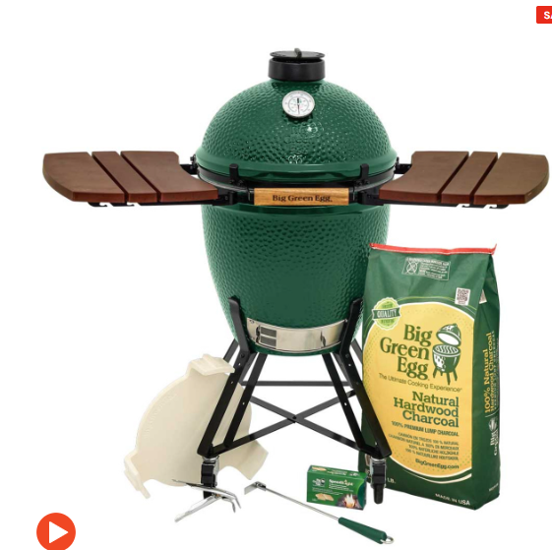
CIF 13th Annual Charity Event ‘Cocktails for a Cause’
Drawing Prize 1
Big Green Egg in Nest with Mates Package
Made possible by these Sponsors

Slide 5
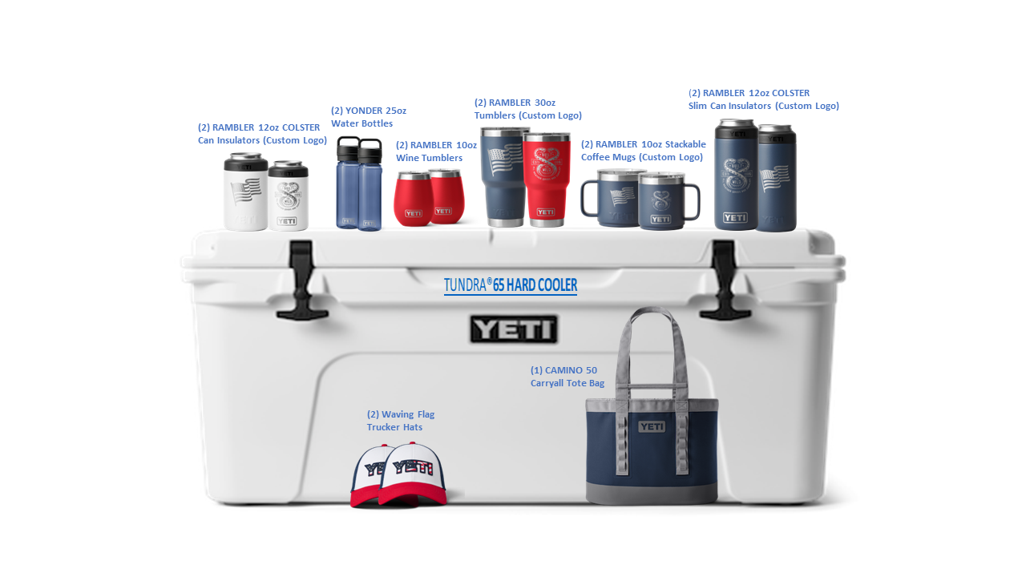
CIF 13th Annual Charity Event ‘Cocktails for a Cause’
Drawing Prize 2
Yeti Cooler
Made possible by

Slide 6
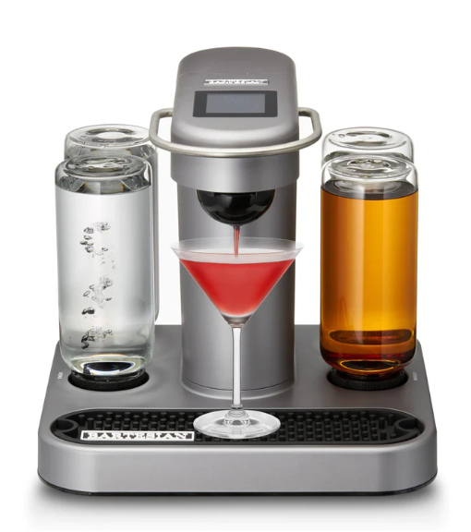
CIF 13th Annual Charity Event ‘Cocktails for a Cause’
Drawing Prize 3
Bartesian Cocktail Mixer
Made possible by these Sponsors

Slide 7
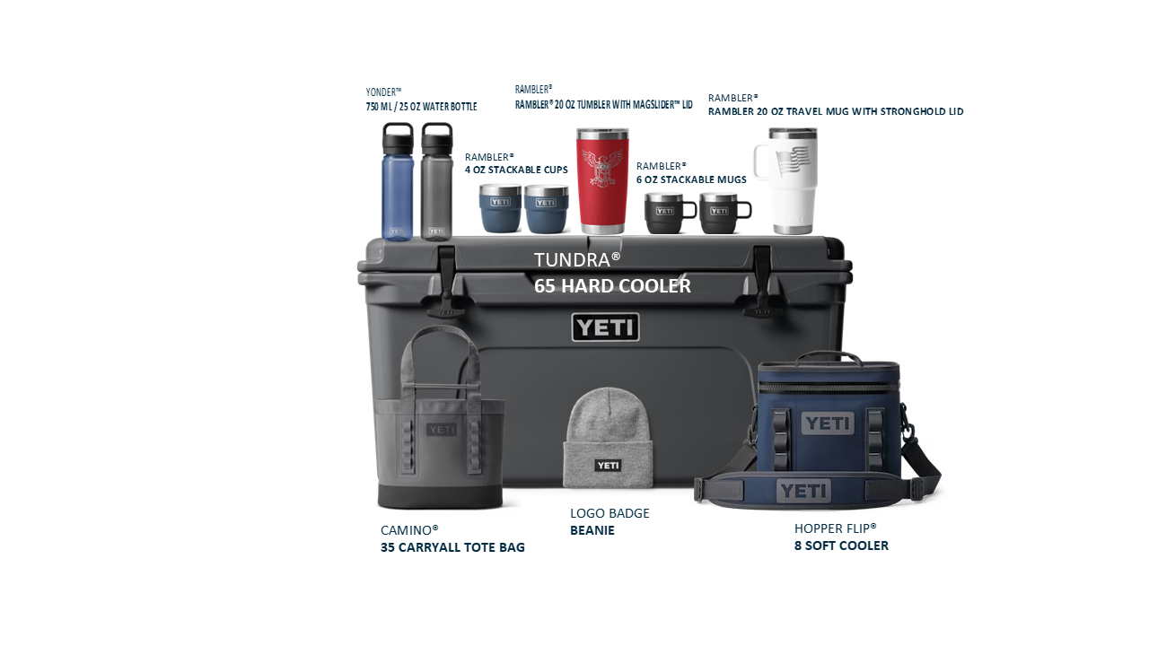
CIF 13th Annual Charity Event ‘Cocktails for a Cause’
Drawing Prize 4
Yeti Cooler
Made possible by

Slide 8
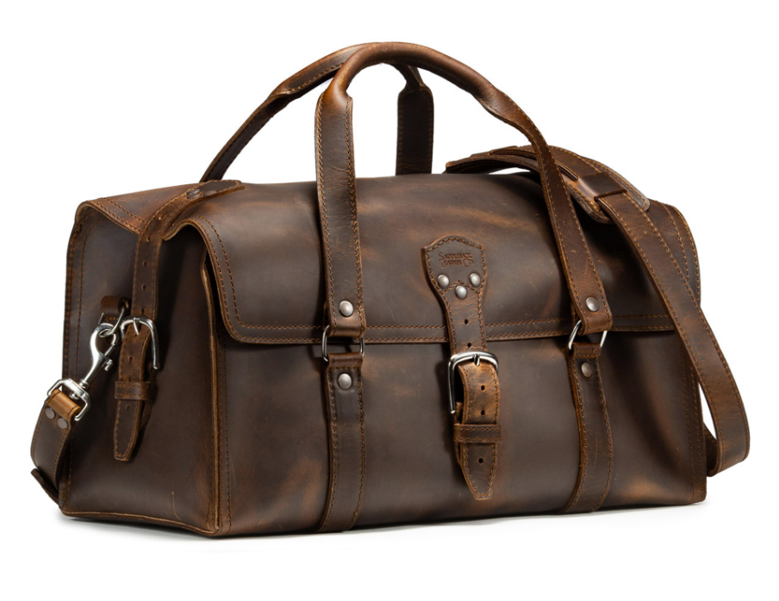
CIF 13th Annual Charity Event ‘Cocktails for a Cause’
Drawing Prize 5
Saddleback Leather Duffle Bag
Made possible by

Slide 9
CIF 13th Annual Charity Event ‘Cocktails for a Cause’
Drawing Prize 6
Louis Vuitton Gift Card
Made possible by these Sponsors

Slide 10
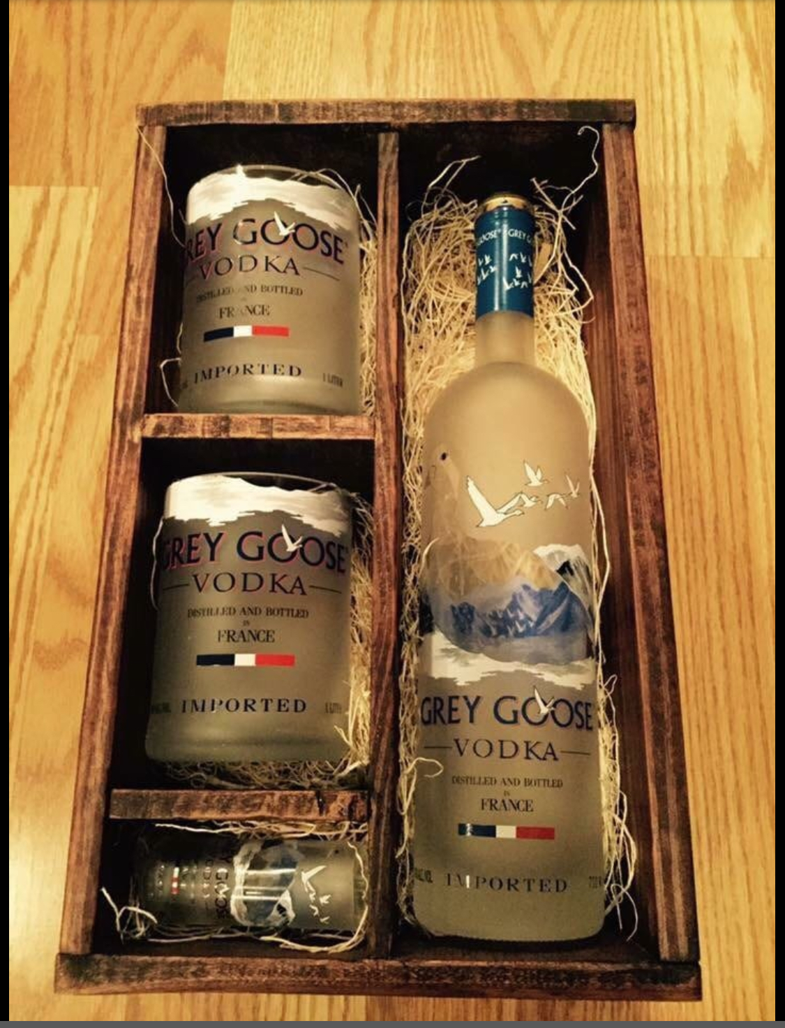
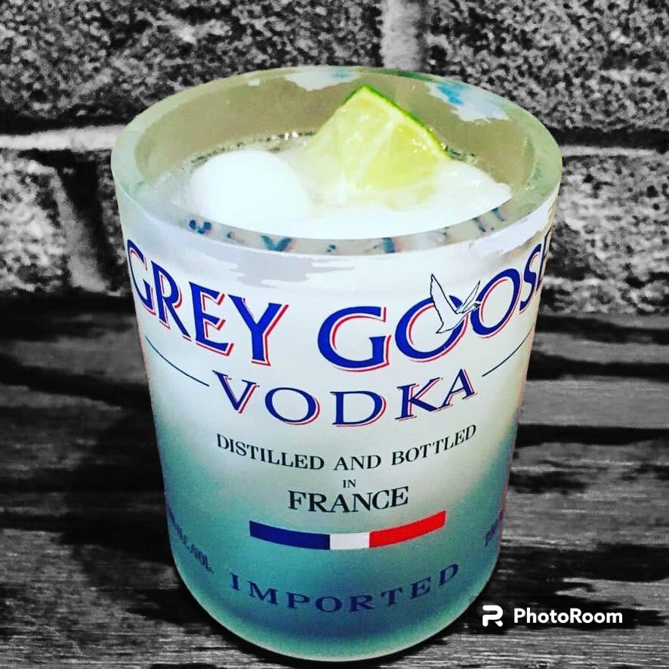
Oh Wait there is more…
Made possible by
Included:
Two Rocks Glasses,
a Shot Glass and – for the purchase of a full bottle Grey Goose Vodka -
a 100$ Gift card
+
Giftset - created from empty bottles.

Slide 11
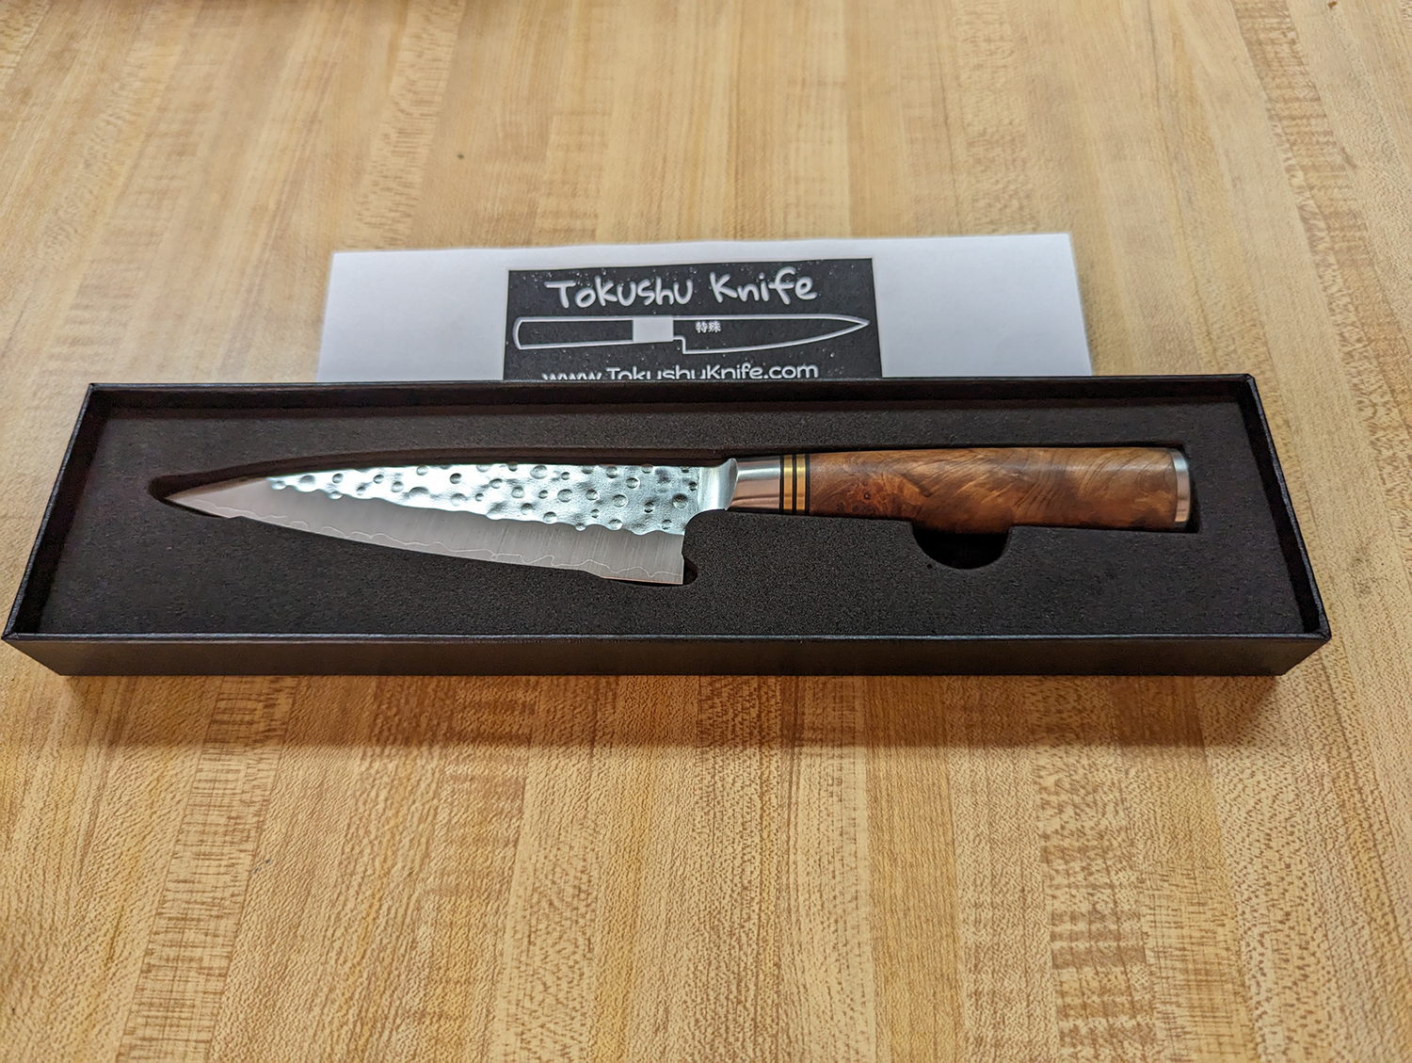
Oh Wait there is more…
The Saji Quince paring knife
Made possible by
Steel: R2 Stainless Steel HRC: 63:64 Edge Length: 130mm Height at heel: 30mm Spine thickness above heel:1.8mm Weight:130 G Handle: Western Style Quince Edge/Bevel: 50/50 Shape: Paring Knife line: R2 Quince
Handmade of stainless steel by one of the most well-known and revered bladesmiths in Japan, Saji Takeshi.

Slide 12
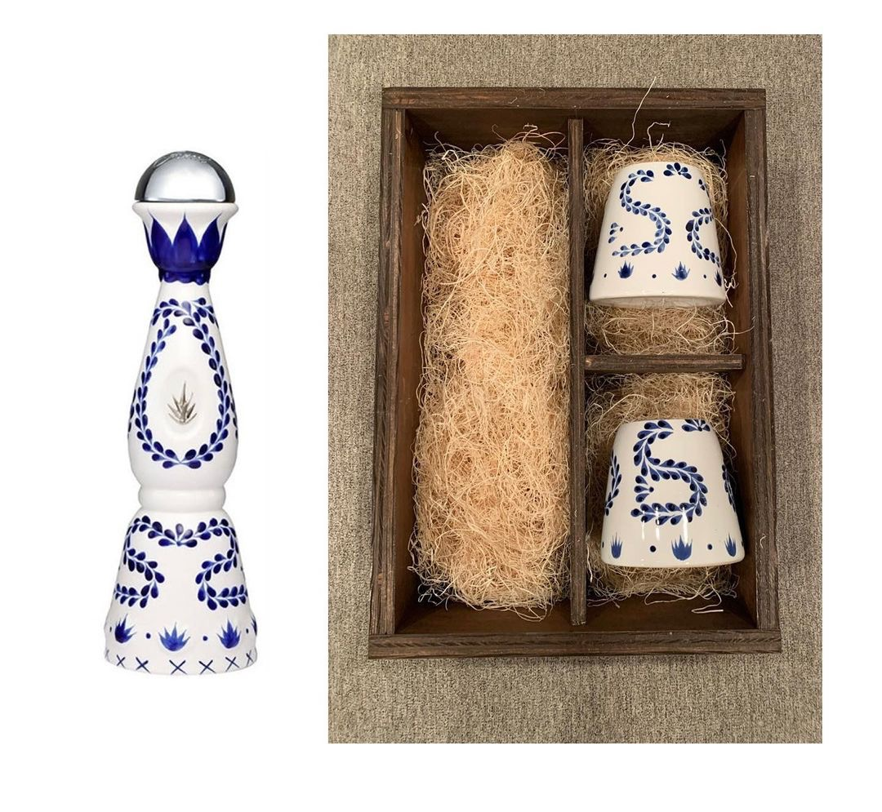
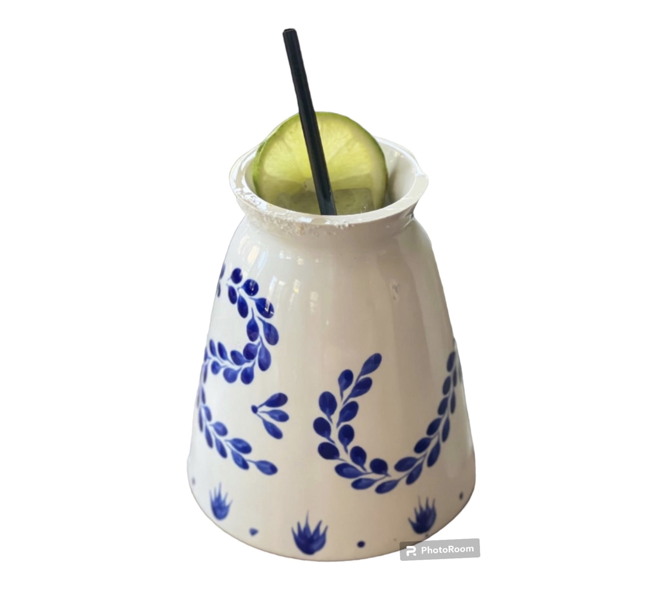
Oh Wait there is more…
Made in Los Altos de Jalisco, Mexico, from from 100% blue weber agave - this Tequila is a perfect blend of artisanal Mexican tradition & modern technology.
Made possible by
Included:
Two Cocktail glasses
Two 100$ Gift cards – for the purchase of a full bottle of Clase Azul Tequila
Giftset - created from empty bottles.
+

